Slide 1
Battle of The Neighborhood
A Clustering approach
- Shashi Kumar

Slide 2
Introduction
Finding a better place or neighborhood to start a business is a bigger problem than the business itself. In this world, full of rapid growth and submerged in technology finding a neighborhood is not a difficult task.
You can easily get the ratings, locality information, neighborhood details, nearby stores at your fingertips.
But getting a reliable and safe neighborhood is a difficult task to handle. There are many vendors who are in search of a better place and can be a tough competitor to the Businesses. Hence targeting those places which have lower supply of what your Business has to offer and lower competitions from the other vendors, is an essential task and a reckless to do from the vendors side.
Hence, this project wishes to explore those places which you should target to grow your Business and target the customers.

Slide 3
Business Problem
Explore the given geographic location and suggest a specific spot in order to maximize the impact of the Business on the targeted audience.
Compare the Neighborhood of the given location with big cities viz. Toronto, New York and cluster them and suggest what could be the similarity between them.
Also specify what sort of business type will be best suitable for these localities.

Slide 4
Target Audience
The model wishes to answer the specific geographic spot which will turn out to be the maximum profit for their businesses. The model has its target audience as
- Small Vendors
- Housewife’s who wish to start a career
- Small startup groups
- Student willing to start something to fun their study
- Large scale retailers, willing to sell in different localities

Slide 5
Data
The data used analysis and recommendation contains the neighborhood details for the New York City and Toronto City.
Data Provider-
For the clustering of the New York neighborhood and segmenting them, the data is available here.
Neighborhood has a total of 5 boroughs and 306 neighborhoods. In order to segment the neighborhoods and explore them, we will essentially need a dataset that contains the 5 boroughs a nd the neighborhoods that exist in each borough as well as the the latitude and longitude coordinates of each neighborhood.
For the Toronto Data Set, the data is provided through:
• Postal Code and Neighborhood: Wikipedia
• Co-Ordinates of the Neighborhood: Geospatial Data
• Localities of Each Neighborhood: Foursquare APIs

Slide 6
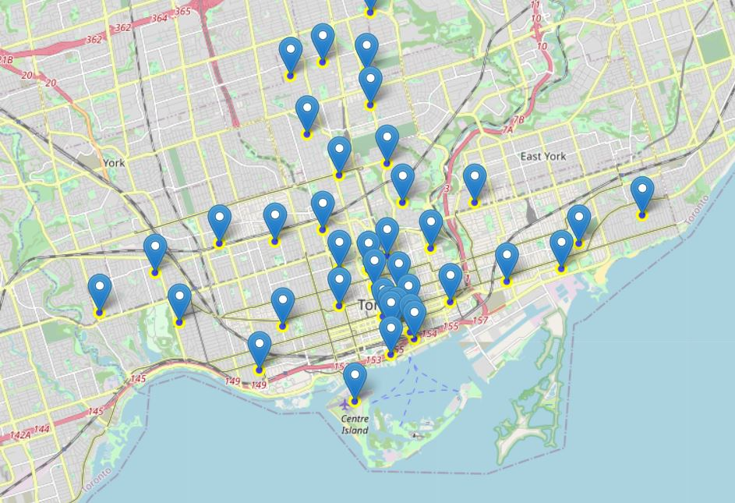
Exploratory Data Analysis
Visualization of Toronto Neighborhood-

Slide 7
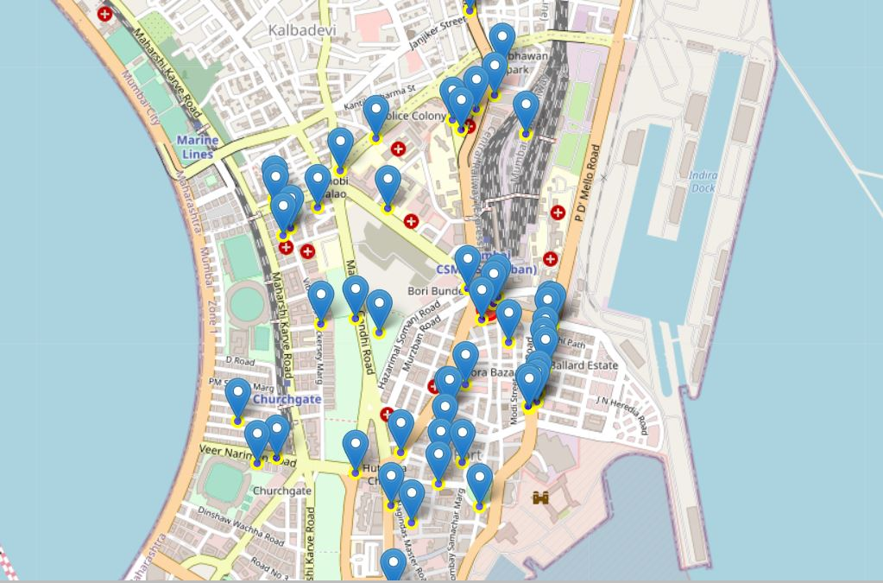
Exploratory Data Analysis
Visualization of Mumbai Venues-

Slide 8
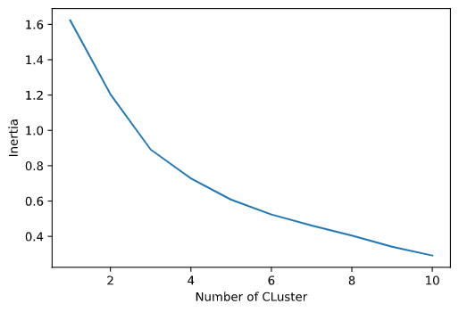
Modeling
The clustering of neighborhood is done using K - Means Clustering Algorithm.
Choosing the Best Number of Cluster-
The right number of clusters is necessary to build a clustering model. The model uses the elbow method to determine the within cluster sum of square using the inertia parameter of the K - Means algorithm. The best number of clusters is choses from the plot.
Clearly from the elbow method
number of clusters should be 5,
as from the graph increasing the
number of clusters further will
not decrease the within cluster
sum of squares much.

Slide 9
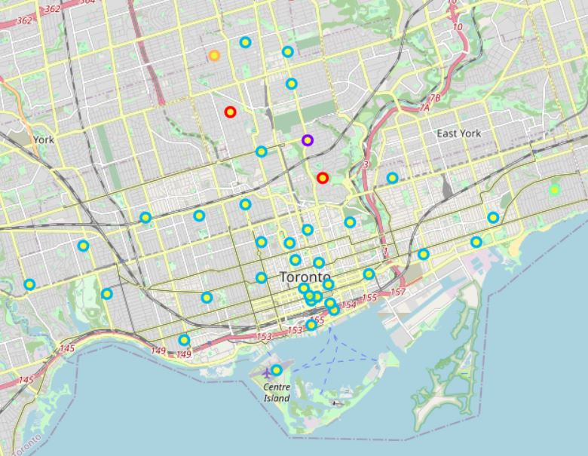
Model Evaluation
Clustering of Toronto Neighborhood-

Slide 10
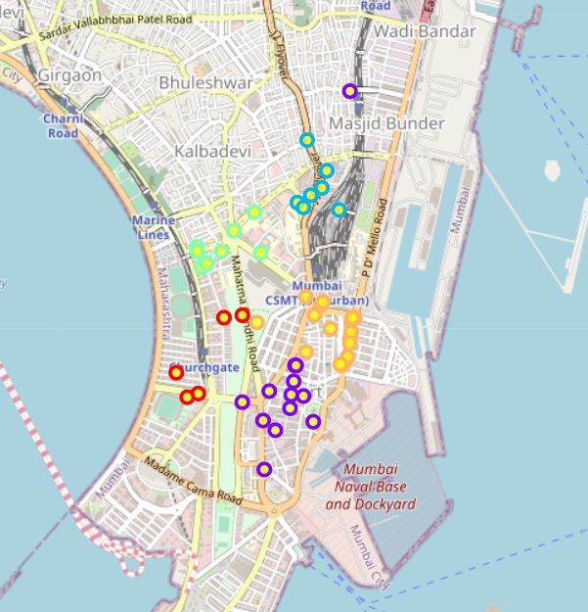
Model Evaluation
Clustering of Mumbai Venues-

Slide 11
Results and Conclusion
For the Toronto Region:
Total number of Neighborhood belonging to cluster 0 are 3
Total number of Neighborhood belonging to cluster 1 is 1
Total number of Neighborhood belonging to cluster 2 are 38
Total number of Neighborhood belonging to cluster 3 are 1
Total number of Neighborhood belonging to cluster 4 is 1
Total venues: 44
For the Mumbai Region:
Total number of Neighborhood belonging to cluster 0 are 12
Total number of Neighborhood belonging to cluster 1 is 10
Total number of Neighborhood belonging to cluster 2 are 17
Total number of Neighborhood belonging to cluster 3 are 6
Total number of Neighborhood belonging to cluster 4 is 5
Total venues: 50

